Slide 1

FluView Data (2015-2020)
DS6373 – Time Series Project
Andy Nguyen
Michael Wolfe
Notes:
Hi my name is Andy Nguyen and I have been collaborating with Michael Wolfe to analyze time series trends in Influenza data from 2015 to 2020.

Slide 2

This data was collected as a viral surveillance process by the U.S. World Health Organization (WHO) Collaborating Labs and National Respiratory and Enteric Virus Surveillance System (NREVSS)
Surveillance began during the 1997-1998 flu season, but we will use a subset of the data starting from October 2015 to February 2020
We are primarily concerned with the influenza surveillance on the national level in the United States
FluView is a weekly influenza surveillance report compiled by the Centers for Disease Control and Prevention (CDC) to analyze flu activity year round in the U.S.
Determine when/where influenza activity is occurring
Determine which type of influenza viral strains are circulating
Detect changes in influenza viruses
Measure the impact influenza is having on the population (outpatient illnesses, hospitalizations, death)
The system is a collaborative effort between the CDC and partnering health departments/laboratories in the U.S.
Specifics detailing the collection methods and purposes of FluView can be found at the following link: https://www.cdc.gov/flu/weekly/overview.htm
Notes:
Weekly FluView surveillance reports have been compiled by the CDC to analyze flu activity year round in the United States since 1997. We will only be using a subset of that data to determine when influenza activity is occurring and how these patterns may be changing over time from October 2015 to February 2020. The objective is to forecast the next flu season with a horizon of 12 weeks or 3 months.
Specific details concerning the collection methods and purposes of this data can be found at the provided link.

Slide 3
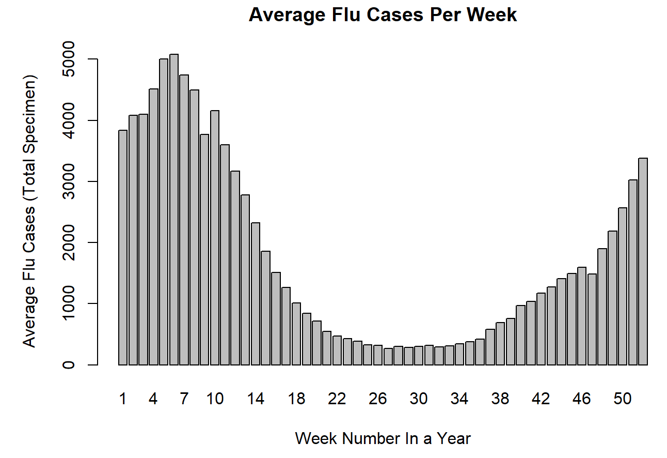

Slide 4
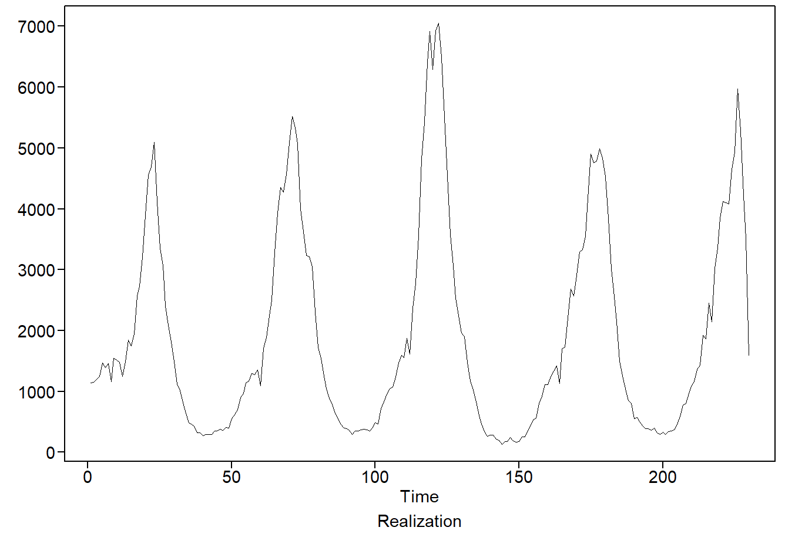
NON-STATIONARY
Notes:
The repeating peaks following roughly a period of 50 also suggests an annual trend in the data and is consistent with the fact that the influenza virus typically circulates every year. This is an indication that the mean depends on time. With this violation, we suspect a non-stationary process.
Visual checks for constant variance and autocorrelations suggest that these constant requirements are satisfied, but we can not assume a stationary process if the mean is not constant throughout the time series.

Slide 5
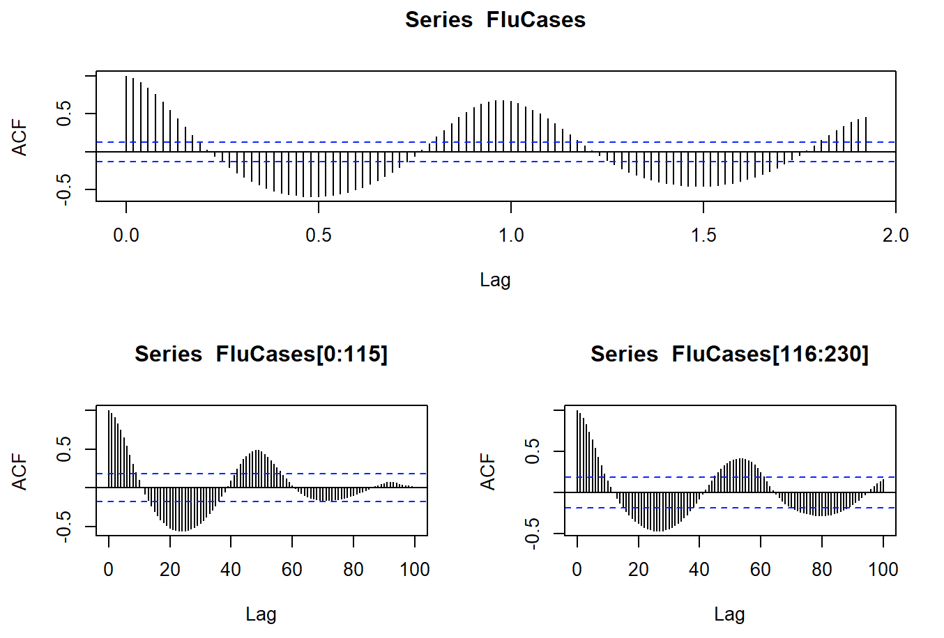
Notes:
The dampening sinusoidal behavior in the ACFs suggest that the time series may contain complex conjugate roots when modeling autoregressive behavior. The apex of the curve seems to repeat at roughly every 50 lags.

Slide 6
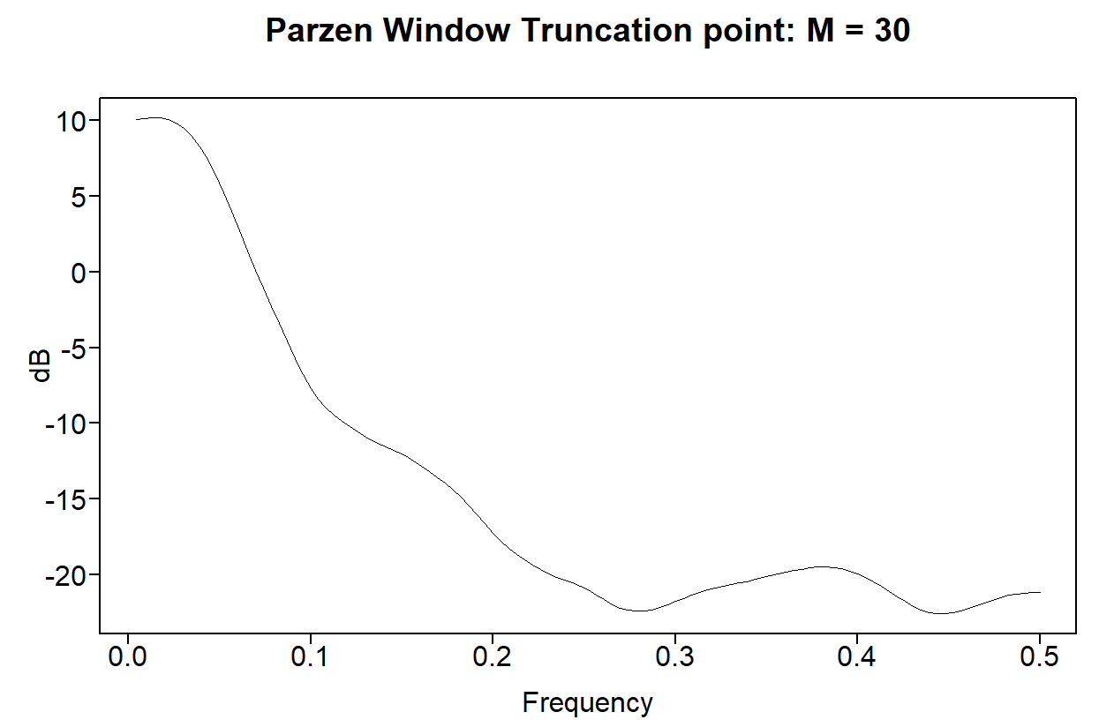
Notes:
The spectral density shows a visible peak at f = 0, suggesting wandering behavior. Two troughs present roughly around f = 0.28 and f = 0.45, suggesting that there are moving average components in the data.

Slide 7
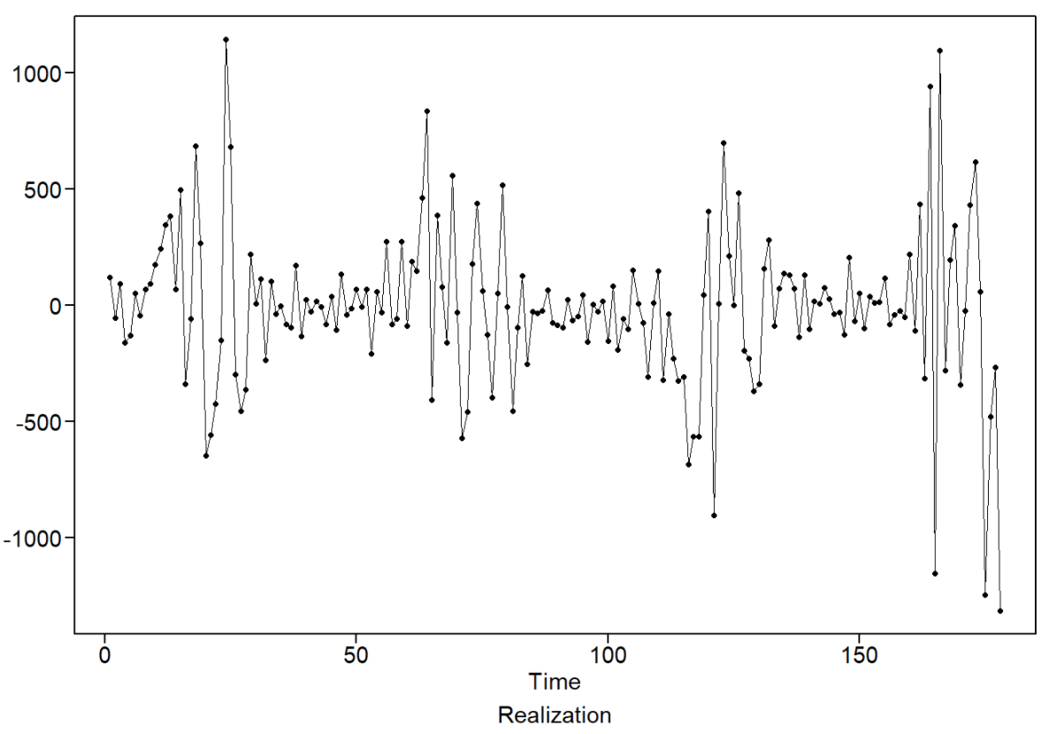
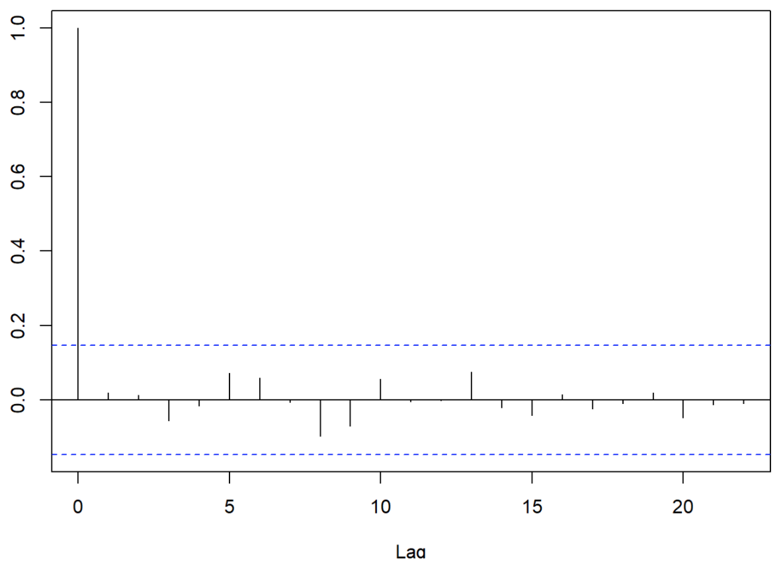
Univariate Analysis: ARUMA(5,0,2) w/ s = 52
AIC = 11.74528
(1 + 0.4387B - 1.1318B² - 0.8121B³ + 0.5319B⁴ + 0.4147B⁵)(1-B⁵²)(X_{t} – 1909.774) = (1 + 1.7094B + 0.8856B²)a_{t}
Variance (σ_{a}²)= 115,311
2 Ljung-Box tests both return p-values > .9
Visual checks indicate white noise
Notes:
Overfit tables were used to diagnose the expected annual trends, but did not provide strong evidence to support a seasonal factor of s = 52 weeks. However, we still suspect an annual trend in the data of 52 weeks because of the typical behavior of flu activity. Using the AIC criterion, we estimated an ARUMA(5,0,2) model following a fifty-second order difference of the data. The 5th autoregressive order and 2nd moving-average order in our model accounts for the damped sinusoidal behavior observed in the ACFs as well as the 2 troughs seen in the spectral density. The factors of the model are all inside the unit circle, with the most dominant factors being 2 complex conjugate roots.
The estimates for the coefficients of the autoregressive and moving-average components are presented in the model equation above. The residuals appear to be whitened in the visual checks shown above in the realization and sample autocorrelations. The Ljung-Box test also provides strong evidence that the data is no longer serially correlated with p-values greater than 0.9 and indicating that this is an appropriate model identification.

Slide 8
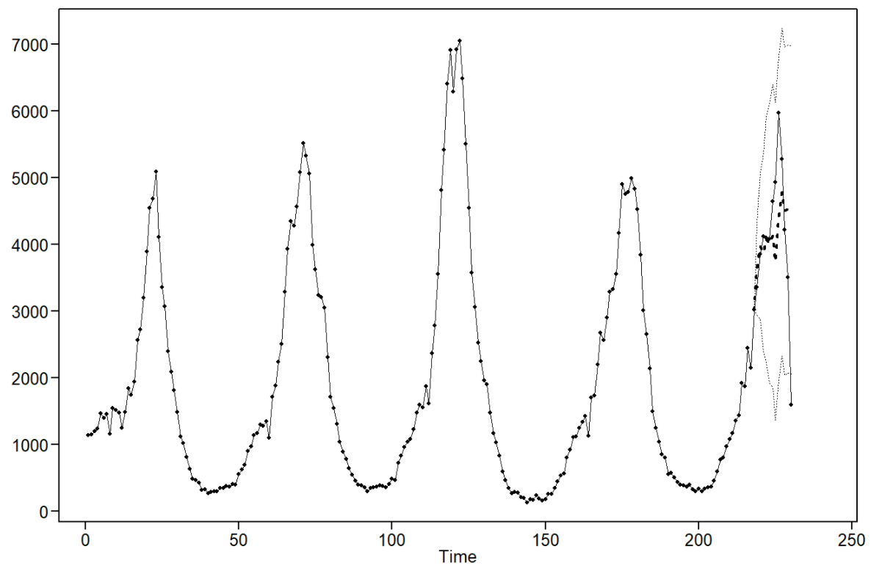
Univariate Analysis: ARUMA(5,0,2) w/ s =52 Forecasts
ASE = 1,185,825
Notes:
The model contains a seasonal component to help the forecasts, but appear to have concerningly wide confidence intervals. However, the predicted forecasts appear to decently follow the trend of the data. Although these seasonal forecasts did not perform the best in terms of ASE, it still provides useful forecasts. Calculating the rolling window ASE for both the univariate models, this seasonal model showed better forecasts throughout the entire time series with a value around 900,000 compared to an ARMA(6,4) rolling window ASE of roughly 2 million. Assuming the data to come from a non-stationary process, it makes sense that this seasonal model generalized better forecasts across the whole time series than the competing stationary ARMA(6,4) model.

Slide 9
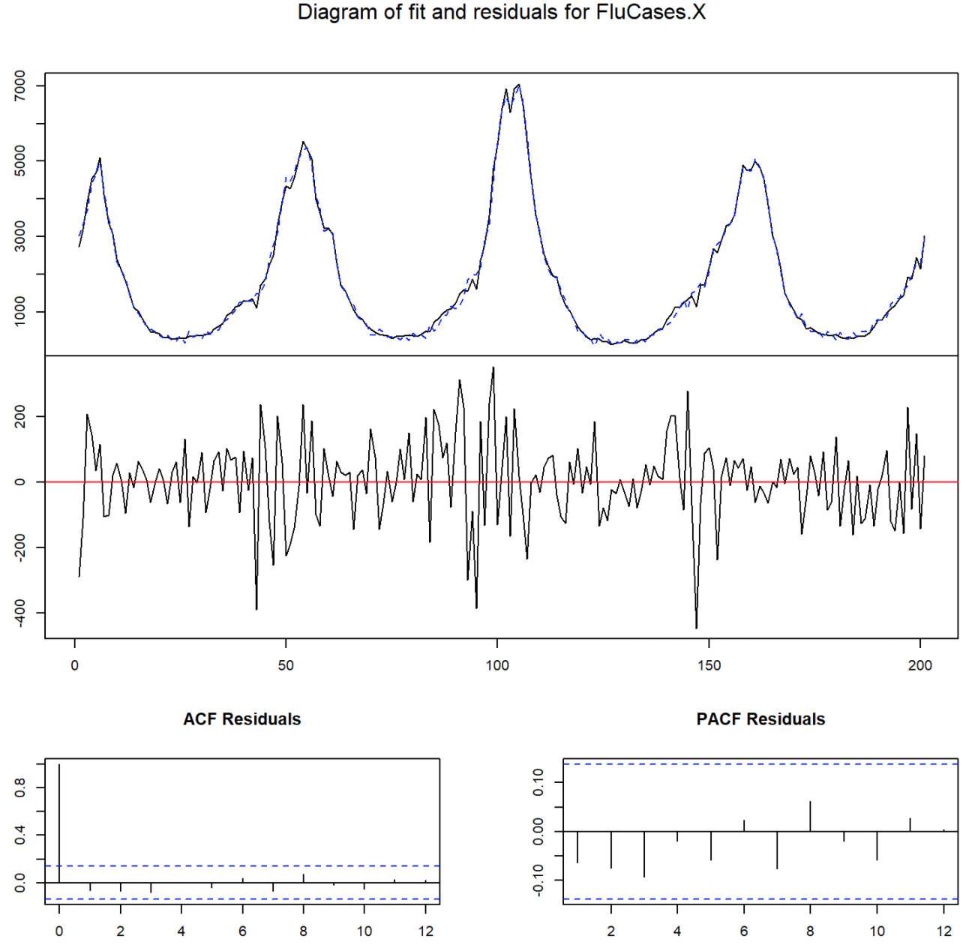
Multivariate Analysis: VAR(17)
Notes:
Building off the unvariate models, we now include additional explanatory variables to help forecast flu activity trends through a multivariate analysis using vector auto-regressive models. These additional variables are the specific subtypes and lineages of influenza viral strains. Using the AIC criterion, a 17th order VAR model was estimated with a deterministic trend regressor and an annual seasonal frequency of 52 weeks. When we fit a VAR model to include a frequency of 52 weeks, the forecasts were unstable and vastly overestimated the actual values with an ASE in the hundred millions. However, the forecasts became much more stable when we did not fit the VAR model to that frequency.
The residuals, fitted values, autocorrelations, and partial autocorrelations for the unfitted VAR(17) model indicate that the residuals have been whitened.

Slide 10
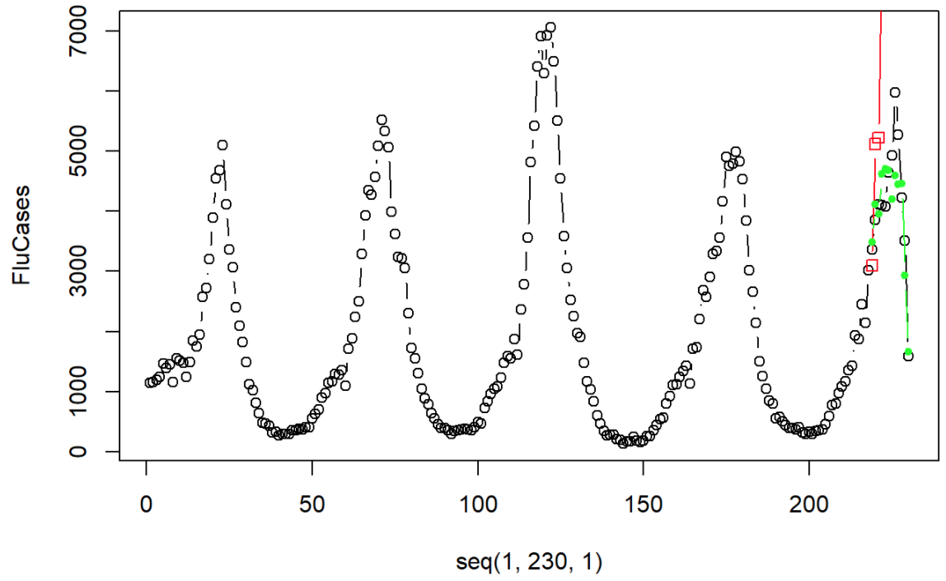
Multivariate Analysis: VAR(17) Forecasts
ASE fitted = 128,585,906
ASE unfitted = 358,671
Notes:
The forecasts for the fitted and unfitted VAR(17) model are shown. Forecasts for the fitted model are red, and nonfitted are green – it is clear to see the fitted model does not follow the trend line at all and begins to extremely overestimate the actual data. The nonfitted model seems to track the trend line. Although it underestimates the peak, this model still produced the lowest ASE of all our competing models. This better performance on an unfitted seasonal frequency suggests that the annual trend we expect can not be modeled using the seasonal frequency factor of (1-B^52).

Slide 11
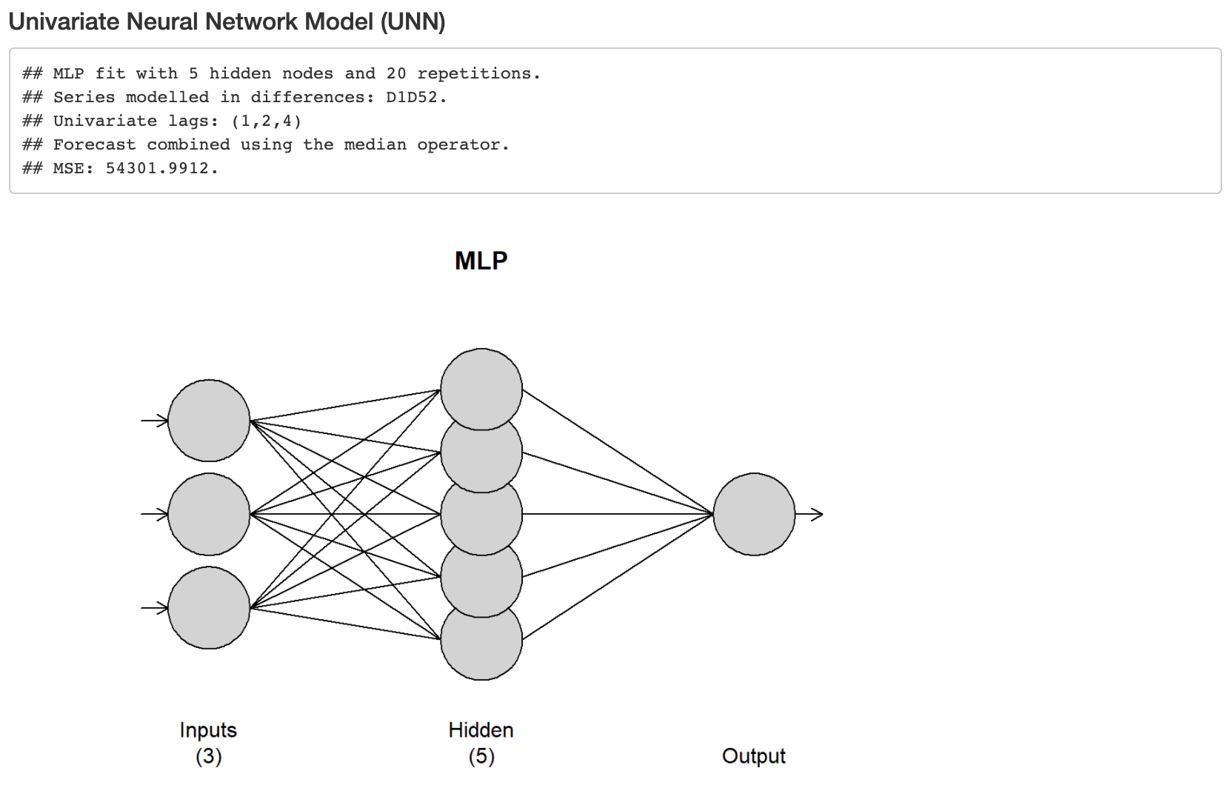
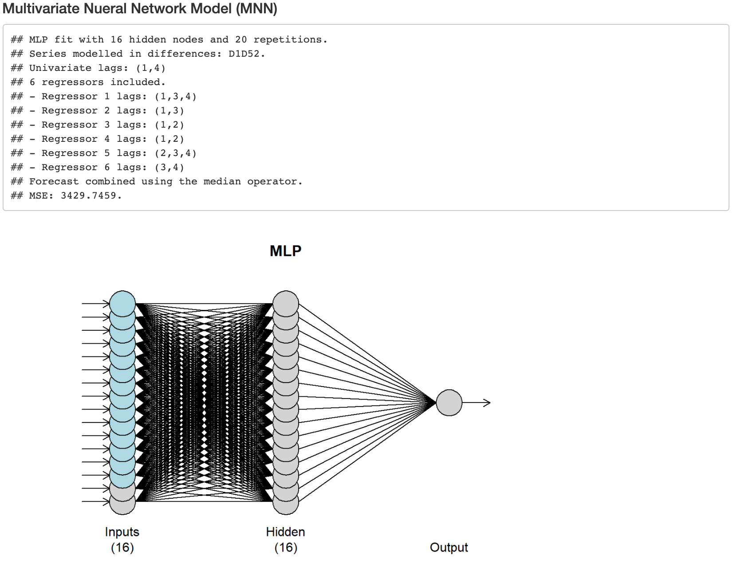
Neural Network Models
Notes:
A univariate neural network was trained using time as an explanatory variable with the data differenced by first and fifty-second orders on 5 hidden nodes in 20 repetitions.
The multivariate neural network included all the explanatory variables used in the VAR model. The optimal number of hidden nodes of 16 was selected using 5-fold cross validation. The expected annual frequency of 52 weeks was also included as a parameter with differences of both a first and fifty-second order when training the neural network on 20 repetitions. The number of lags for all regressors were automatically selected through the algorithm. Comparing the MSE of the forecasts calculated using the median operator, the UNN was 53,344.91 and the MNN was 3,257.49

Slide 12
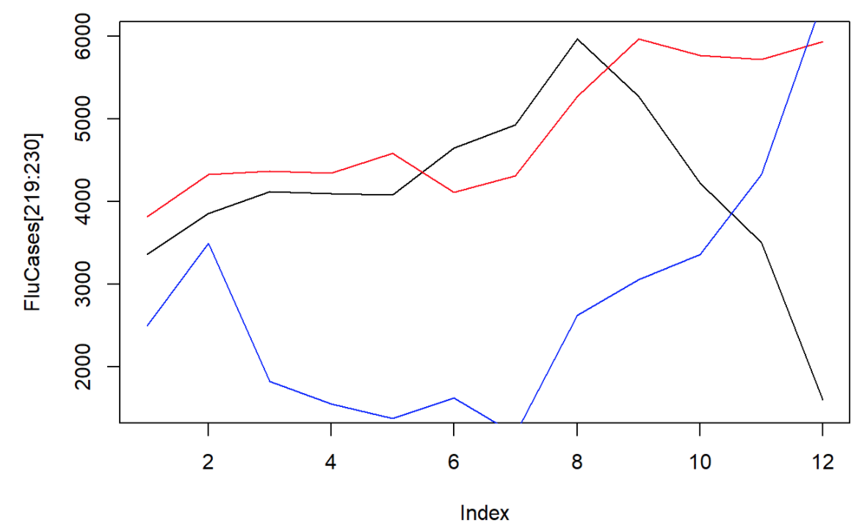
Neural Network Forecasts
UNN ASE = 1,959,621.28
MNN ASE = 2,717,874.75
Notes:
However, the calculated ASE of the last 12 weeks of the data was better for the UNN (1,959,621.28) than the MNN (2,717,874.75).
Comparing the forecats from each model (UNN: red, MNN: blue), the UNN forecasts appear to overlap better with the actual data while the MNN forecasts consistently underestimate until about the 11th week. Based off the ASE, the UNN model appears to be more useful at forecasting the flu data. From these last 12 weeks, the UNN forecasts exhibits the most similar behavior despite the peak being predicted later in time. The MNN forecasts were also unable to pick up the decreasing trend following the 8th forecast, and instead continues to increase after the 10th forecast.

Slide 13
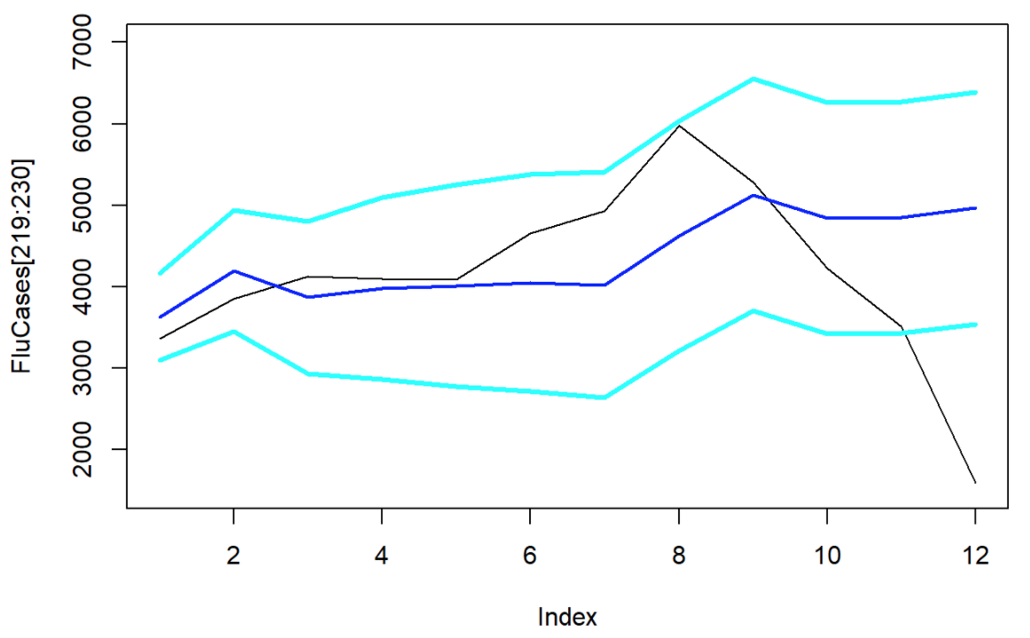
Ensemble Model Forecasts
ASE = 1,403,968
Forecasts = [3631, 4195, 3871, 3977, 4010, 4047, 4020, 4627, 5129, 4840, 4853, 4964]
Lower Prediction Limit = [3097, 3451, 2935, 2861, 2770, 2720, 2635, 3219, 3708, 3418, 3431, 3540]
Upper Prediction Limit = [4164, 4938, 4806, 5093, 5249, 5374, 5405, 6035, 6549, 6262, 6275, 6388]
Notes:
We found the most useful model to be a non-stationary ensemble pairing the seasonal ARUMA model with the univariate neural network. Although this model does not have the lowest ASE, we found that it performs well in tracking the behavior in the data up until 9 weeks and more closely follows the peak-and-valley trends of the realization. The last 3 weeks of the forecast are when the predictions begin to fall off, with a trend that appears to increase instead of decreasing to follow the actual data.
In addition to these useful forecasts, this model was selected because we believe the data comes from a non-stationary process and should be modeled as such with a seasonal component. However, this model still requires more fine-tuning to better approximate the last few forecasts and capture the decreasing trend of the data rather than an increase.

Slide 14
Conclusion
Data on Influenza Activity from the past years comes from a non-stationary process, although stationary models also performed well
Seasonal ARUMA(5,0,2) w/ s = 52 model showed good generalized forecasts in rolling window ASE
Annual trend in the data is not modeled well with a seasonal factor of (1-B⁵²)
Chosen non-stationary model requires more fine-tuning to better approximate last few forecasts
Future analyses should look into Signal-Plus Noise Model using sine or cosine function with a period of 52 weeks
Notes:
The analysis of influenza activity over the past 5 years indicates that the data comes from a non-stationary process. We found that the rolling window ASE showed that the non-stationary ARUMA(5,0,2) w/ s = 52 showed better generalized forecasts over the whole time series rather than just the last 12 forecasted weeks.
We also noted that when we estimated our VAR(17) model with 6 explanatory variables with a seasonal frequency of 52, but did not actually fit the VAR model with that frequency, the ASE was the lowest of all models at 358,672. We believe this indicates that the annual trend can’t be modeled using seasonal frequency factors of s = 52 weeks.
Our final non-stationary ensemble model provided the most useful forecasts that were able to capture some of the behaviors observed in the last 12 weeeks of flu activity, but begins to become unstable and overestimates the last few weeks. Further analyses should look into modeling flu actvity with a deterministic signal using sine or cosine functions with a period of 52 weeks.

